Slide 1
Weather Tools
Brought to you by:
Ms. Graham
8-12-19 to 8-16-19

Slide 2
Monday 8-12-19
Q.O.D
What is Weather?
the state of the atmosphere at a place and time as regards heat, dryness, sunshine, wind, rain, etc.

Slide 3
Locker Practice with Mrs. Parrish

Slide 4
Tuesday 8-13-19
Q.O.D.
What is a Weather Map?
A map or chart chowing weather conditions over a wide area at a particular time.

Slide 5
Wednesday
8-14-19
Q.O.D.
  If I own an animal shelter and I bring the cats into the same room to live as the dogs, I am trying to ______the animals.
  Explain how you know the answer.
  --Answer
  Integrate

Slide 6
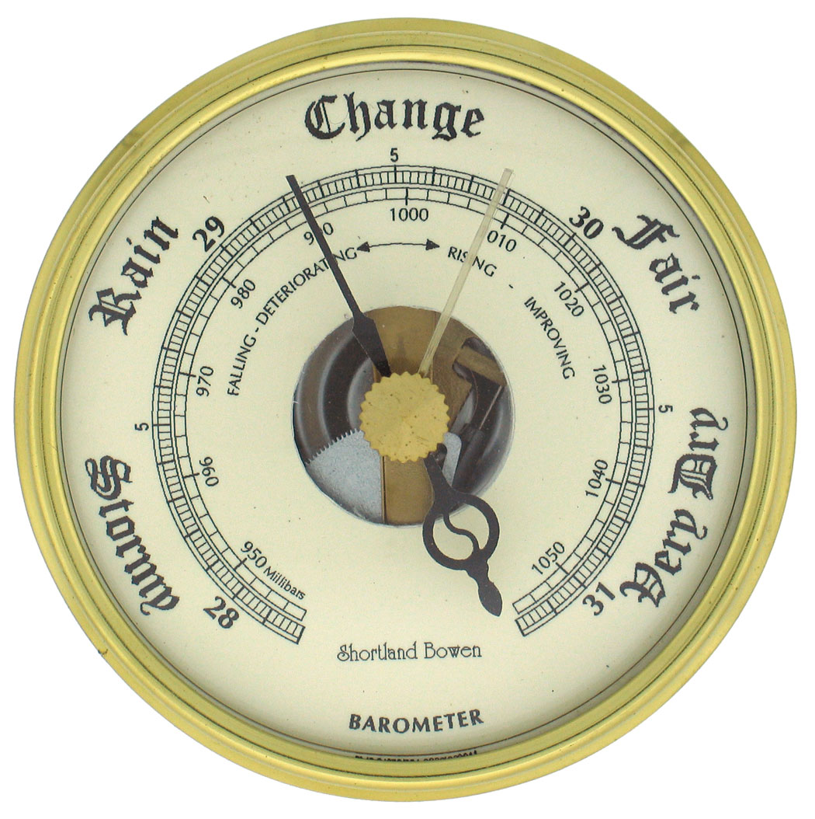
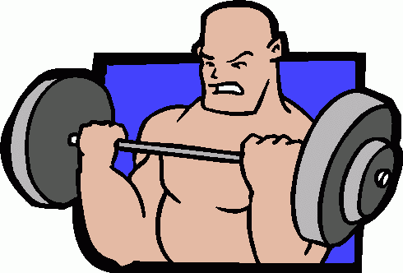
Barometer
A tool used to measure air pressure
The weight of air pushing on the earth’s atmosphere
Think:
Barbell= weightlifting
Bar= weight of air

Slide 7
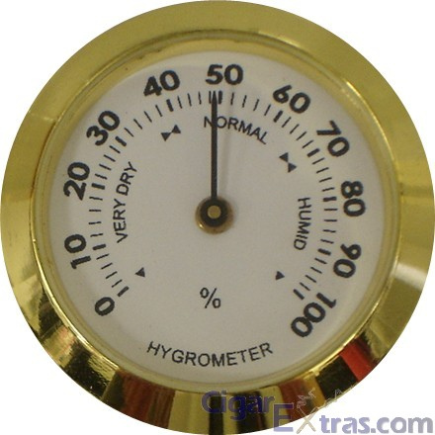
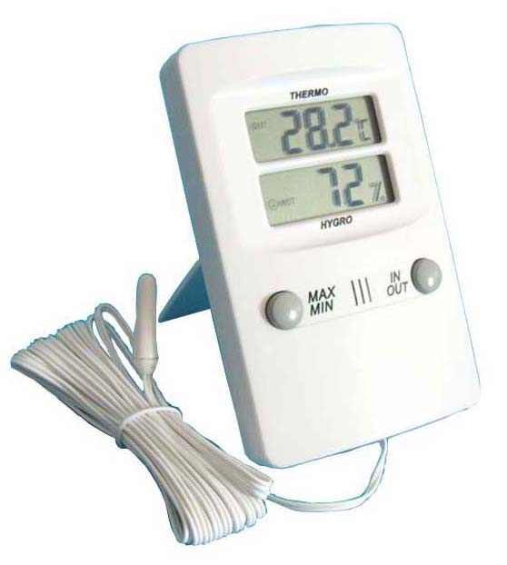
Hygrometer
A tool used to measure humidity
How much water is in the air?
Think: h=humidity
h= hygrometer

Slide 8
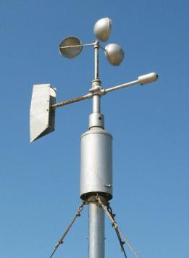
Anemometer
A tool used to measure the wind speed
How fast is the wind blowing?
Think: Ants= move fast
Anemometer= how fast wind is moving

Slide 9
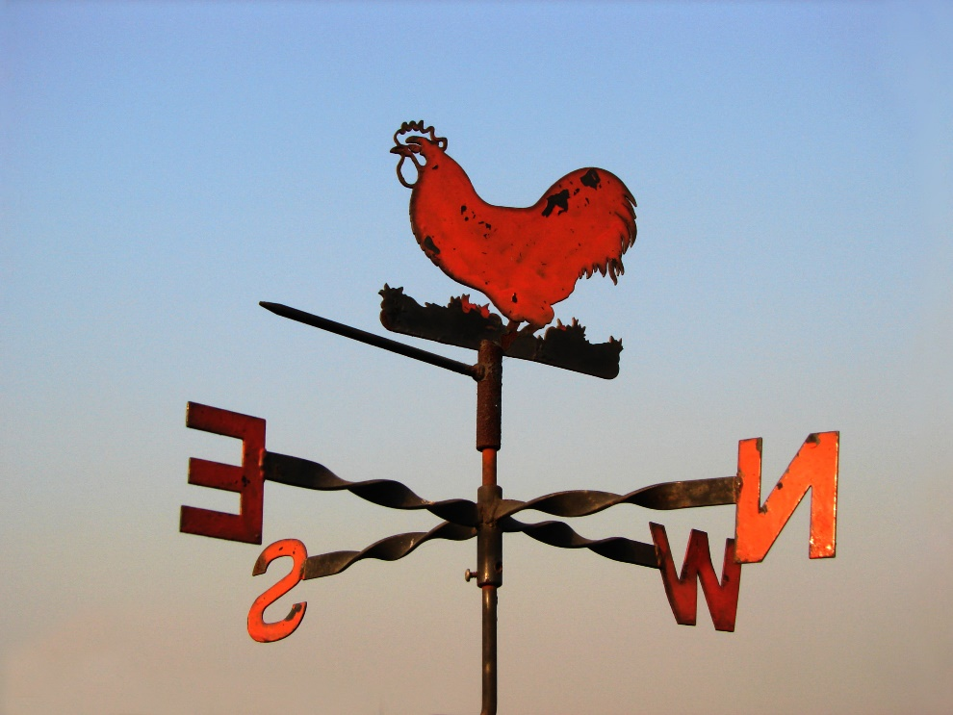
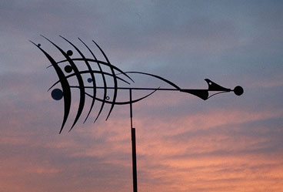
Wind Vane
A tool used to measure the DIRECTION of the wind
The arrow points in the direction from which the wind is blowing
Think: wind vane =
rooster on roof!

Slide 10
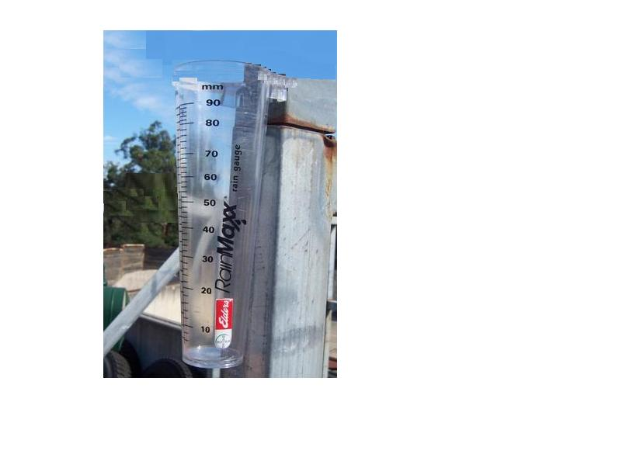
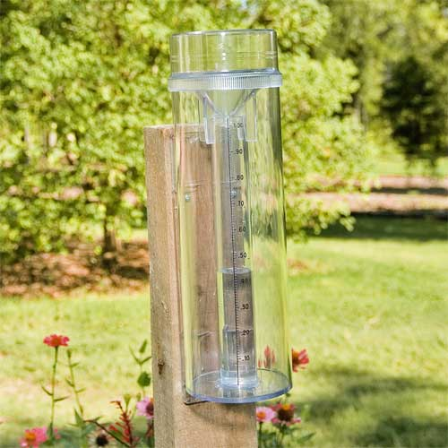
Rain Gauge
A tool used to measure the amount of rainfall
How much rain have we received in Lewisville during the month of February?

Slide 11
Exit Question
Tell me three things you have learned today.
Identify 1 thing you are not clear on.
--Study—Mini Quiz Friday 8-16-19

Slide 12
Thursday 8-15-19
Q.O.D.
Slides 13-20
Oral Review of slides for understanding of content
Mini-Q ( Mini Quiz) on Friday 8-16-19

Slide 13
Thursday 8-15-19
Q.O.D
  What are tools used for?
  --Answer
  Tools are used to help us complete a job.

Slide 14
Hygrometer
Katie wants to measure the amount of moisture in the air. She does not want the water in the air to disorder her hair. What instrument should she use?

Slide 15
ANEMOMETERR!
Mrs. Hartman plans to go out over the weekend on her new sailboat. First, she must know how fast the wind is blowing to see if it’s appropriate to sail. What instrument should she use?

Slide 16
THERMOMETER!
Mrs. Leab wants to make sure that she dresses Baby Joseph correctly when she brings him to visit us. In order for her to know the temperature outside, what instrument should she use?

Slide 17
WIND VANE!
Mr. Snow just bought a brand new kite and he is anxious to fly it. Before he flies it, he must be cognizant of the DIRECTION of the wind. What instrument should he use?

Slide 18
BAROMETER!
A meteorologist observes some cumulonimbus clouds outside. He speculates that there is LOW air pressure. What instrument should he use to determine the air pressure?

Slide 19
RAIN GAUGE!
Ryan is working on his Science Fair project. He plans to measure the amount of rainfall that has fallen in his neighborhood over the past two weeks. What instrument should he use?

Slide 20
Exit Question
What is the most difficult weather instrument to remember.
Explain why.
Mini-Q Friday 8-16-19

Slide 21
Friday 8-16-19
Q.O.D.
Oral Review
Mini-Q
Review results if enough time.

